Slide 1
InsightEats Case Study
By: Gabriel Chan
Oct 30, 2025

Slide 2
About Me
Lead Full Stack Data Engineer
Key Highlights
Led team of 8 senior developers on-premises solution migration to Google Cloud end to end consisting of 30+ ETL Hadoop workflows, 10+ data sources, 15+ schemas, 900+ tables, 100+ GB of data, 3 complex graph database containers and 110 API endpoints serving up to 170+ customers and applications with 200k+ API calls daily.
Certifications:
Artificial Intelligence Operations (AIOps) Fundamentals, TM Forum
Google Professional Data Engineer, Google Cloud
Google Associate Cloud Engineer, Google Cloud
Google Cloud Digital Leader, Google Cloud
Hashicorp Certified: Terraform Associate
Tech Stack: Google Cloud Platform (BigQuery, BigTable, Dataproc, Cloud Functions, Cloud Run), Hadoop, PySpark, ETL Pipelines, Docker, Terraform, Helm Charts, GitLab, Python, FastAPI, Node.js v22, JavaScript, TypeScript, React 18, Vue 3

Slide 3
Agenda
Problem Statement
Architecture Design
Overall Assumptions
Data Discovery
Data Modeling
Pipeline Example
DAG Workflow
Data Normalization
Failure Scenario
AI Integration

Slide 4
Problem Statement
Current Situation
InsightEats currently do not have stable data pipelines needed for traditional Business Intelligence(BI) analytics or future Artificial Intelligence (AI) use cases. There are 3 critical data sources that need to be onboarded which are QuickBite, MealDash and FoodNow.
Solution
Data Exploration and Discovery needed to incorporate into stable data pipelines needed to drive BI and build towards AI usecases.

Slide 5
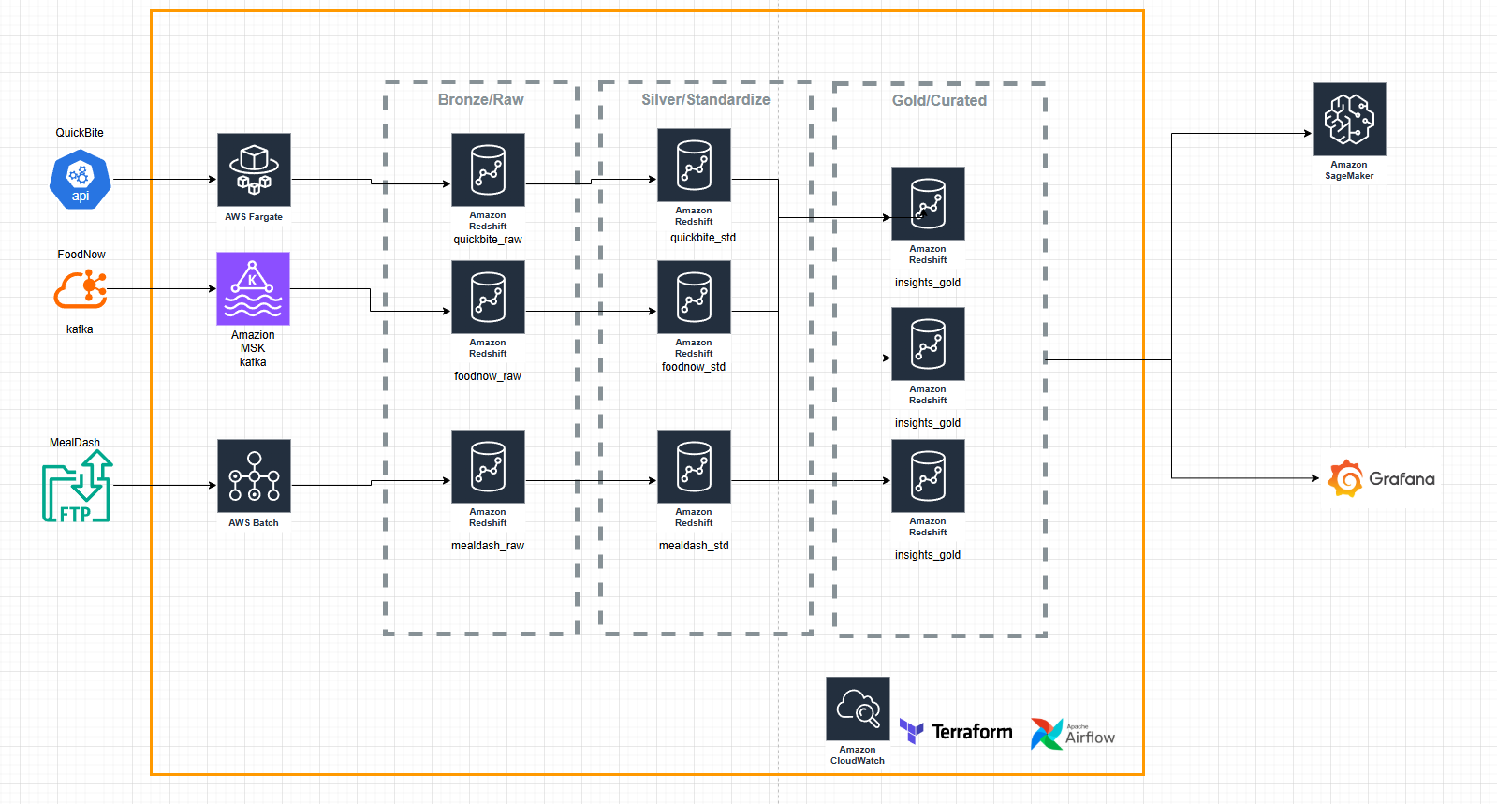
Architecture Design

Slide 6
Overall Assumptions
working with couriers to develop data contracts
Service Level Agreement(SLA) with couriers/ "signing" a contract
menu items may have inconsistent naming (might need mapping)
all currency in USD
There is currently no data architecture for insights and analysts are going directly to sources to infer BI analytics.
The insights on data sources are only what is provided:
QuickBite – REST API with JSON payloads (orders, deliveries, customer actions in near real-time; frequent menu updates)
MealDash – Daily CSV + YAML files via SFTP (revenue, transactions, customer feedback, menu data)
FoodNow – Kafka event streams + XML partner reports (driver statuses, delivery tracking, promotions)
Data sources need to be ingested based on refresh rates
All courier platforms need to have some sort of customer information, transaction/revenue information, menu information, delivery tracking, restaurant and promotions to function.

Slide 7
Data Exploration & Discovery - Contract/Template
Field | Description | Example
Data Source Name | Name of the partner or system providing the data | QuickBite
Data Owner | Contact person or team responsible for data accuracy | data-team@quickbite.com
Contract Version | Version number for the data contract | v1.2
Effective Date | When this contract takes effect – useful for when this needs to update or if contract is outdated | 2025-10-26
Data Refresh Frequency | How often data is delivered | Near real-time / Daily / Hourly
Delivery Method | How the data is provided | REST API, SFTP, Kafka, Pub/Sub, etc.
Connection Information | API key, OAuth, SSH key, usename/password | OAuth 2.0
Data Schema | Used for validations/monitoring of data | { orderNumber : int orderName: string }

Slide 8
Data Exploration & Discovery - QuickBite
Contract Field | Data Source Information
Data Source Name | QuickBite
Data Owner | QuickBite API contact@gmail.com
Contract Version | V1.0
Effective Date | Oct 30,2025
Data Refresh Frequency | Near real-time
Delivery Method | Rest API with Json payloads
Connection Information | API key/token
Data Schema | Will not go further for case study
Notes:
This should be in a json/yaml format to use to validate against when doing pipeline integration and monitoring

Slide 9
Data Exploration & Discovery - FoodNow
Contract Field | Data Source Information
Data Source Name | FoodNow
Data Owner | FoodNow_kafka contact@gmail.com
Contract Version | V1.0
Effective Date | Oct 30,2025
Data Refresh Frequency | Kafka event stream ( even based)
Delivery Method | Kafka
Connection Information | Kafka servers with SSL/TLS keys
Data Schema | Will not go further for case study
Notes:
This should be in a json/yaml format to use to validate against when doing pipeline integration and monitoring

Slide 10
Data Exploration & Discovery - MealDash
Contract Field | Data Source Information
Data Source Name | Meal Dash
Data Owner | Mealdash_csv@gmail.com
Contract Version | V1.0
Effective Date | Oct 30,2025
Data Refresh Frequency | Daily
Delivery Method | CSV + YAML files
Connection Information | SFTP passwordless or username/password auth
Data Schema | Next slide
Notes:
This should be in a json/yaml format to use to validate against when doing pipeline integration and monitoring

Slide 11
Data Exploration & Discovery - MealDash - Cont
{
"data_source_name": "MealDash",
"data_owner": "mealdash_csv@gmail.com",
"contract_version": "v1.0",
"effective_date": "2025-10-30",
"data_refresh_frequency": "daily",
"delivery_method": "CSV + YAML files",
"connection_information": {
"protocol": "SFTP",
"authentication_methods": ["passwordless", "username_password"],
"notes": "Preferred method: SSH key-based (passwordless).",
"host": "sftp.mealdash.com",
"username": "ftp_user",
"password_secret_name": "ftp-password-secret",
"file_path": "/path/to/data.csv",
"s3_destination": "s3://my-bucket/ftp_data/"
},
"data_schema_reference": "mealdash_schema_v1.json",
"description": "Daily delivery of MealDash order, revenue, feedback, and menu data to InsightEats. Delivered via secure SFTP as CSV and YAML metadata files."
}
Notes:
This should be in a json/yaml format to use to validate against when doing pipeline integration and monitoring

Slide 12
Data Exploration & Discovery - MealDash – Data Schema
{
"orders": [
{ "name": "order_id", "datatype": "bigint", "required": true },
{ "name": "menu_id", "datatype": "bigint", "required": true },
{ "name": "revenue_id", "datatype": "bigint", "required": true },
{ "name": "quantity", "datatype": "integer", "required": true },
{ "name": "price", "datatype": "double", "required": true },
{ "name": "promotion_id", "datatype": "bigint", "required": false }
]
}
Notes:
This should be in a json/yaml format to use to validate against when doing pipeline integration and monitoring

Slide 13
Data Modelling
QuickBite
Orders, deliveries, customer actions, frequent menu updates
MealDash
Revenue, transactions, customer feedback, menu data
FoodNow
Driver statuses, delivery tracking, promotions
Assumption: All courier platforms need to have some sort of customer information, transaction/revenue information, menu information, delivery tracking, restaurant and promotions to function.

Slide 14
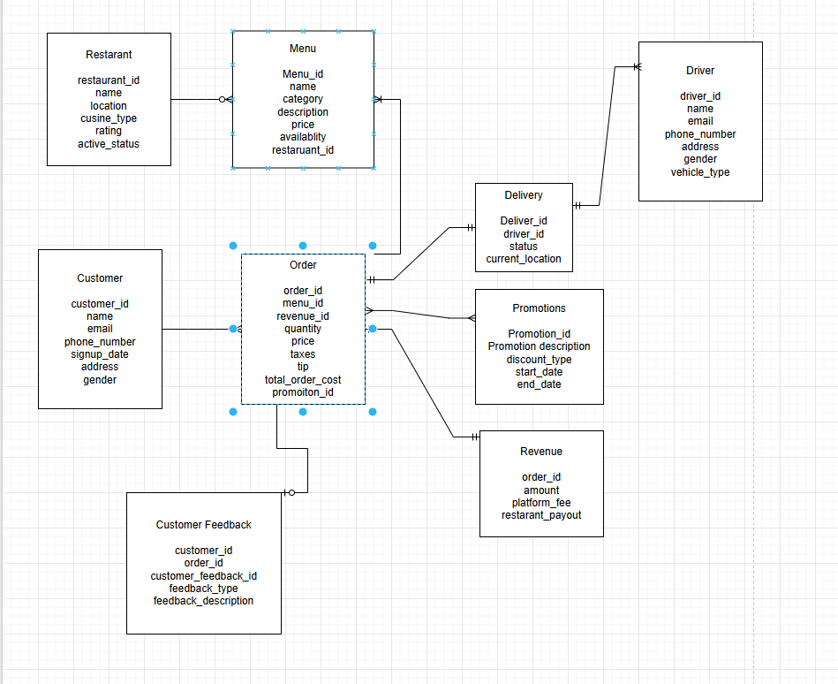
Data Modelling - Tables
Notes:
Task more towards orders and menus

Slide 15
Order Table
Name | Datatype | Description
order_id | STRING / UUID | Unique identifier for each order.
menu_id | STRING / UUID | Identifier referencing the menu item associated with the order.
revenue_id | STRING / UUID | Foreign key linking to the corresponding revenue record.
quantity | INTEGER | Number of units of the menu item ordered.
price | DECIMAL(10,2) | Price per unit of the menu item at the time of order.
taxes | DECIMAL(10,2) | Taxes
tip | DECIMAL(10,2) | Customer tips
total_order_cost | DECIMAL(10,2) | Total cost of the order
promotion_id | STRING / UUID | Identifier referencing any promotion applied to the order.

Slide 16
Menu Table
Name | Datatype | Description
menu_id | STRING / UUID | Unique identifier for each menu item.
name | STRING | Name of the menu item.
category | STRING | Category of the menu item (e.g., appetizer, main course, beverage).
description | STRING / TEXT | Detailed description of the menu item.
price | DECIMAL(10,2) | Price of the menu item.
availability | BOOLEAN | Indicates whether the menu item is currently available.
restaurant_id | STRING / UUID | Identifier referencing the restaurant offering the item.

Slide 17
Revenue Table
Name | Datatype | Description
order_id | STRING / UUID | Unique identifier referencing the associated order.
amount | DECIMAL(10,2) | Total revenue generated from the order before fees.
platform_fee | DECIMAL(10,2) | Fee charged by the delivery platform for processing the order.
restaurant_payout | DECIMAL(10,2) | Net amount paid to the restaurant after deducting platform fees.

Slide 18
Delivery Table
Name | Datatype | Description
delivery_id | STRING / UUID | Unique identifier for each delivery.
driver_id | STRING / UUID | Identifier for the driver assigned to the delivery.
status | STRING | Current status of the delivery (e.g., pending, in_transit, delivered).
current_location | STRING / JSON | Real-time location of the driver or delivery, typically in coordinates.

Slide 19
Pipeline Example - Data Ingestion
Broken by data source types, for each type there should be a separate system.
REST API (JSON Format input)
FTP(CSV or YAML)
Kafka
Handling schema drift can be handled through the data contracts on data schemas and enforcing strict typing only when standardizing
Json, csv and yaml files can be ingested to data lakes/Amazon s3 buckets as an initial phase then use AWS glue data catalog for scanning
Kafka can also utilize AWS glue data catalog schemas
Notes:
Can use aws glue dynamicframe method

Slide 20
Pipeline Example - Data Ingestion - REST API (JSON Format input)
Feature / Aspect | AWS Lambda | AWS Fargate
Purpose | Event-driven serverless compute for short-lived functions | Serverless container execution for continuous or long-running services
Runtime Model | Executes code on demand (cold starts possible); max 15 min runtime | Runs containerized applications continuously or per task; no time limit
API Hosting | Integrates with API Gateway for REST/HTTP endpoints | Integrates with Application Load Balancer (ALB) or API Gateway for container-based APIs
Performance & Latency | Fast, but can experience small latency from cold starts | Consistent performance; containers stay warm for instant response
Scalability | Auto-scales instantly per request (fine-grained scaling) | Auto-scales by adjusting number of running tasks based on load
Workload Type | Ideal for lightweight, stateless, event-driven APIs | Ideal for persistent APIs or heavier compute that needs longer execution
Execution Time Limit | 15 minutes maximum per invocation | No time limit — containers can run indefinitely
Cost Considerations | Pay only per request and execution time (GB-seconds) — cost-effective for sporadic traffic | Pay per vCPU-second and GB-second — better for steady workloads with consistent demand
Cold Start Behavior | Possible; adds 100–300 ms on first request after idle period | None once service is running (containers stay warm)
Integration Options | Deeply integrated with S3, DynamoDB, Kinesis, EventBridge, Step Functions | Integrates with ECS, ECR, RDS, ALB, CloudMap, and Service Discovery
Typical Workflow | API Gateway → Lambda → DynamoDB/S3/RDS | ALB/API Gateway → ECS (Fargate) container → RDS/S3
Best For | Event-driven or bursty REST APIs, short tasks, webhooks | Persistent REST APIs, microservices, or APIs needing long-running compute

Slide 21
Pipeline Example - Data Ingestion - REST API (JSON Format input)
AWS Fargate is the best choice for this REST API because it provides always-on, containerized compute with consistent low-latency performance, which is crucial for near real-time workloads. Unlike AWS Lambda, which can introduce cold starts and has a 15-minute execution limit, Fargate runs continuously active containers, ensuring requests are processed instantly with no startup delay.

Slide 22
Pipeline Example - Data Ingestion - Kafka
Feature / Aspect | Amazon MSK | AWS Glue Streaming
Primary Role | Real-time data ingestion & buffering | Real-time ETL transformation & loading
Core Function | Managed Kafka message broker | Managed Spark Streaming ETL service
Input / Output | Producers → Kafka Topics → Consumers / Connectors | Kafka / Kinesis → Transformed data → S3 / Redshift
Transformations | None (raw stream only) | Yes — supports data cleansing, validation, joins
Schema Handling | Optional via Glue Schema Registry | Native schema inference + validation
Latency | Sub-second | Seconds to minutes (micro-batch)
Durability / Replay | Persistent message retention (replay supported) | No persistence; transient stream processing
Scalability | Scales via Kafka partitions | Scales by DPUs (compute resources)
Management Level | Managed Kafka cluster (still topic management) | Fully managed ETL jobs (no infra management)
Integration | Works with MSK Connect, Glue, Lambda, Firehose | Direct output to Redshift, S3, DynamoDB
Pricing Model | Pay per broker-hour + storage | Pay per DPU-hour
Best Use Case | Continuous data ingestion & buffering | Continuous or near real-time data transformation/loading
Typical Pipeline Role | Ingest / Stream Layer | Transform / Load Layer

Slide 23
Pipeline Example - Data Ingestion - Kafka
Amazon MSK is the optimal choice for external Kafka ingestion, offering fully managed Kafka, high durability, low-latency streaming, and seamless integration with Redshift, while enabling delayed business logic transformations with Athena for flexible and cost-efficient analytics.

Slide 24
Pipeline Example - Data Ingestion - FTP (CSV or YAML)
Feature / Aspect | Amazon EMR | AWS Batch | AWS Glue
CSV Transformation | Optimized for large-scale transformations using Spark/Hive; handles multiple CSVs in parallel | Must implement transformation in container/script; can process CSVs sequentially or concurrently | Native ETL using PySpark; can read multiple CSVs from S3, transform, and write back to S3/Redshift
Data Size Handling | Best for medium → very large datasets (GB → TB) | Small → medium datasets (MB → few GB per job) | Medium → large datasets (GB → TB), serverless Spark handles parallelism
Parallelism / Scalability | Auto-distributes across cluster nodes; excellent for multiple CSVs | Can run multiple jobs concurrently; scaling is manually configured | Auto-parallelizes using DPUs; handles multiple CSVs in parallel
Incremental / Streaming | Spark Streaming jobs possible for incremental CSV updates | Each job is batch-triggered; no native streaming | Glue Streaming jobs available for near-real-time CSV ingestion
Schema Handling | Schema inference supported; can validate CSV headers & data types automatically | Must implement manually in script | Schema inference, validation, and catalog integration with Glue Data Catalog
Automation | Step Functions, Glue, or EMR scheduled jobs | Job queues, Step Functions, EventBridge triggers | Built-in job scheduler, workflow orchestration, and triggers
Cost Considerations | Pay for EC2 instances + EBS + EMR fees; good for large CSVs | Pay for underlying compute resources; cheaper for small CSV batches | Pay per DPU-hour + storage; serverless and cost-efficient for medium-large CSV loads
Typical Workflow | S3 → EMR Spark → transformed data → S3/Redshift | S3 → Batch job container → output to S3/Redshift | S3 → Glue ETL job → S3/Redshift
Notes:
Good contender aws transfer family directly to S3 bucket

Slide 25
Pipeline Example - Data Ingestion - FTP(CSV or YAML)
Justification for AWS Batch: AWS Batch is the ideal choice for processing small-to-medium CSV workloads because it provides a cost-effective, flexible, and easy-to-manage solution. Unlike EMR or Glue, it does not require managing clusters or provisioning DPUs, which would be unnecessary overhead for this scale. Batch allows each CSV file or batch of files to be processed independently in containers, enabling parallel execution when needed, while keeping costs predictable. It also integrates easily with scheduling and event-driven workflows, making it well-suited for daily ingestion pipelines with lightweight transformations. Overall, AWS Batch meets the current workload’s scale, complexity, and budget efficiently.

Slide 26
Pipeline Example - Data Ingestion - FTP(CSV or YAML) - pseudocode
Json config based
Check for schema validations all with data contract
If schema check does not pass then do not load into table
Show in vscode

Slide 27
DAG Workflow- Data transformation pseudocode
Using configurable yaml files with Amazon redshift sql queries to transform from raw to standardization
Imposing proper datatypes (if not done so already)
true nulls
Trimming whitespaces
Using DAGS to call on ingestion pipelines and sql pipelines passing on parameters
Show in vs code with how it links with ingestion
Notes:
Show in vs code

Slide 28
Data Normalization
Creating tables for list of beverage items, mains and appetizer names to normalize order items to different categories
SELECT o.order_id, b.price, (oi.quantity * b.price) AS total, 'beverage' AS category
FROM orders o
JOIN order_items oi ON o.order_id = oi.order_id
JOIN beverages b ON oi.beverage_name = b.name
UNION ALL
SELECT o.order_id, m.price, (oi.quantity * m.price) AS total, 'main' AS category
FROM orders o
JOIN order_items oi ON o.order_id = oi.order_id
JOIN mains m ON oi.main_name = m.name
UNION ALL
SELECT o.order_id, a.price, (oi.quantity * a.price) AS total, 'appetizer' AS category
FROM orders o
JOIN order_items oi ON o.order_id = oi.order_id
JOIN appetizers a ON oi.appetizer_name = a.name;

Slide 29
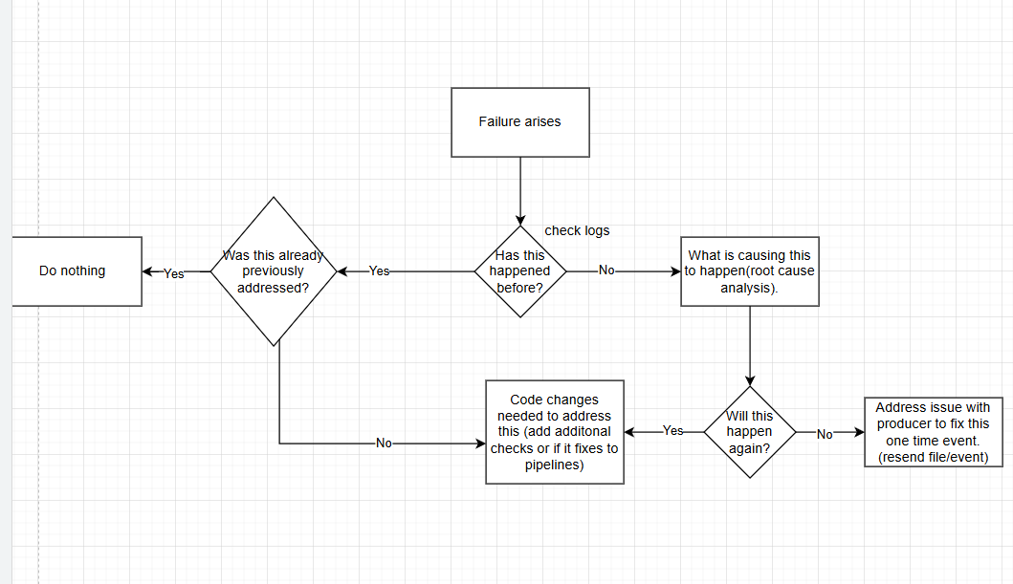
Failure Scenario
- Describe how you would detect, alert, and resolve if:
- QuickBite API returns malformed JSON
- MealDash uploads a corrupted CSV
- FoodNow - Kafka stream goes down for 30 minutes.

Slide 30
Failure Scenario - QuickBite API returns malformed JSON/MealDash uploads a corrupted CSV
Some possible scenarios
Malformed/corruption is the new structure for the api call
Schema changes might need to be address via code (new schema versioning via contract)
2. Malformed/corruption only happens once in a while
Schema retains the same, error handling would need to make sure this does not get loaded (should already be done)
A way to handle output to fit schema if possible (will need discussion with producers/analysts)

Slide 31
Failure Scenario - FoodNow - Kafka stream goes down for 30 minutes.
if this is normal behaviour, need to increase timeouts to adjust to this and monitor occurrences

Slide 32
Failure Scenario - Monitoring
1. Overview / Health Panel
Purpose: High-level system health
Widgets:
DAG Success Rate: % of DAGs succeeded in last 24h
Batch Jobs Status: Pie chart of SUCCEEDED / FAILED / RUNNING jobs
Fargate Task Health: % of healthy vs. unhealthy tasks
Kafka Cluster Health: Brokers up / down

Slide 33
Failure Scenario - Monitoring
2. Airflow DAGs Panel
Widgets:
DAG Run Timeline: Success/failure over time
Task Duration: Average duration per DAG
Retry Counts: Number of retries per DAG/task
SLA Misses: Count and list of DAGs missing SLAs
Alerts:
DAG failure
SLA misses
Tasks stuck > threshold duration

Slide 34
Failure Scenario - Monitoring
3. AWS Batch Panel
Widgets:
Job Queue Length: Number of jobs waiting to run
Job Status Distribution: Running / Failed / Succeeded
Job Duration Trend: Average runtime per job
Compute Environment Utilization: vCPU & memory usage
Alerts:
Failed jobs
Jobs stuck > threshold
Compute environment under/overutilization

Slide 35
Failure Scenario - Monitoring
4. AWS Fargate Panel
Widgets:
Task Status: Running / Stopped / Failed
CPU & Memory Usage: Per service / task
Network Traffic: Inbound/outbound per task
Container Logs: Recent errors/warnings
Alerts:
Task failures
High CPU/memory usage
Unhealthy container status
5. AWS Kafka / MSK Panel
Widgets:
Broker Health: CPU, memory, disk usage per broker
Topic Throughput: Messages in/out per second
Consumer Lag: Lag per consumer group
Partition Status: Under-replicated / offline partitions
Alerts:
Broker down
Consumer lag > threshold
Disk usage > threshold
Under-replicated partitions

Slide 36
Failure Scenario - Monitoring
6. Alerts / Notifications Panel
Centralized list of all active alerts:
DAG failures / SLA misses
Batch job failures or long queue
Fargate unhealthy tasks
Kafka consumer lag / broker issues
Delivery Channels: Email, Slack

Slide 37
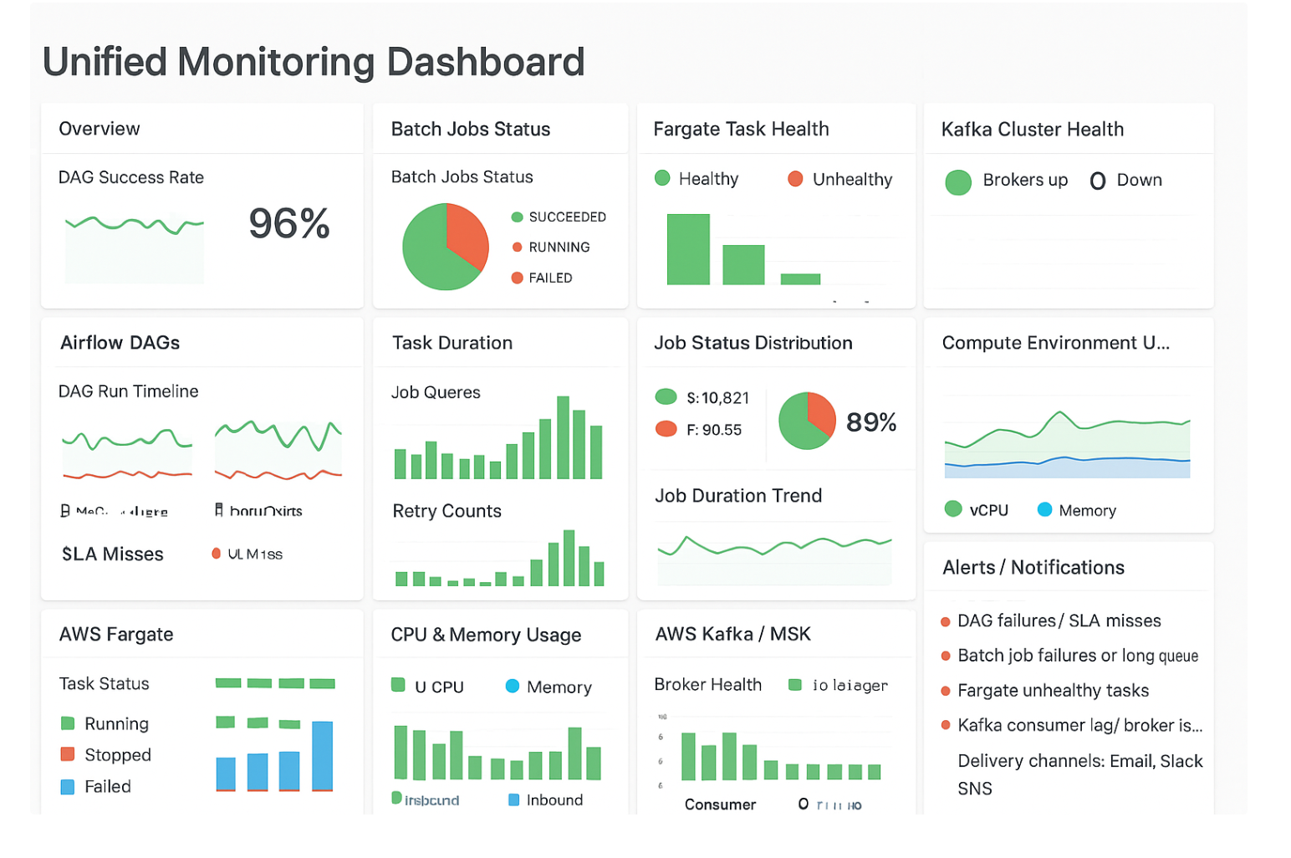
Failure Scenario - Monitoring

Slide 38
Exploratory Analysis for BI Revenue
Feature / Aspect | Amazon QuickSight | Amazon Managed Grafana
Primary Use Case | Business Intelligence, self-service analytics, executive dashboards | Operational monitoring, metrics tracking, time-series analysis, multi-source dashboards
Audience | Business analysts, management, marketing, product teams | Operations teams, data engineers, SREs, real-time monitoring teams
Data Sources | Redshift, RDS, S3, Athena, Salesforce, other BI sources | Redshift, CloudWatch, Prometheus, Elasticsearch, multiple streaming sources
Data Latency | Mostly batch / near real-time with SPICE caching | Real-time or near-real-time streams, live metrics
Dashboard Focus | Trend analysis, comparisons, KPI tracking, customer insights | System health, delivery metrics, real-time orders, anomaly detection
Visualization Types | Bar charts, line charts, scatter plots, heat maps, pivot tables, KPI widgets | Line charts, gauges, heat maps, tables, alerts, annotations, composite dashboards
Interactivity | Filters, drill-downs, parameter controls, ad-hoc queries | Time-range selectors, live-updating panels, annotations, alert triggers
AI/ML Integration | Can connect to ML predictions via Redshift or SageMaker for forecasting, recommendations | Limited AI/ML; primarily visualizes outputs of models or operational metrics
Alerting | No native alerting (requires email/Slack via API) | Built-in alerting on thresholds, anomalies, or missing data
Strengths for InsightEats | Revenue trends, failed deliveries, top-selling categories, menu performance, executive dashboards | Real-time delivery tracking, driver performance, ingestion pipeline monitoring, anomaly detection on revenue/orders
Recommended Scenarios | Historical reporting, BI dashboards for management, high-level metrics | Operational dashboards for engineering, monitoring ingestion pipelines, live order tracking, alerting

Slide 39
Exploratory Analysis for BI Revenue
Grafana is the best fit because InsightEats needs:
Real-time dashboards for ingestion pipelines and delivery events
Multi-source integration (Redshift, Kafka, CloudWatch)
Built-in alerting for quick insights on abnormalities
More flexibility in terms of data manipulation

Slide 40
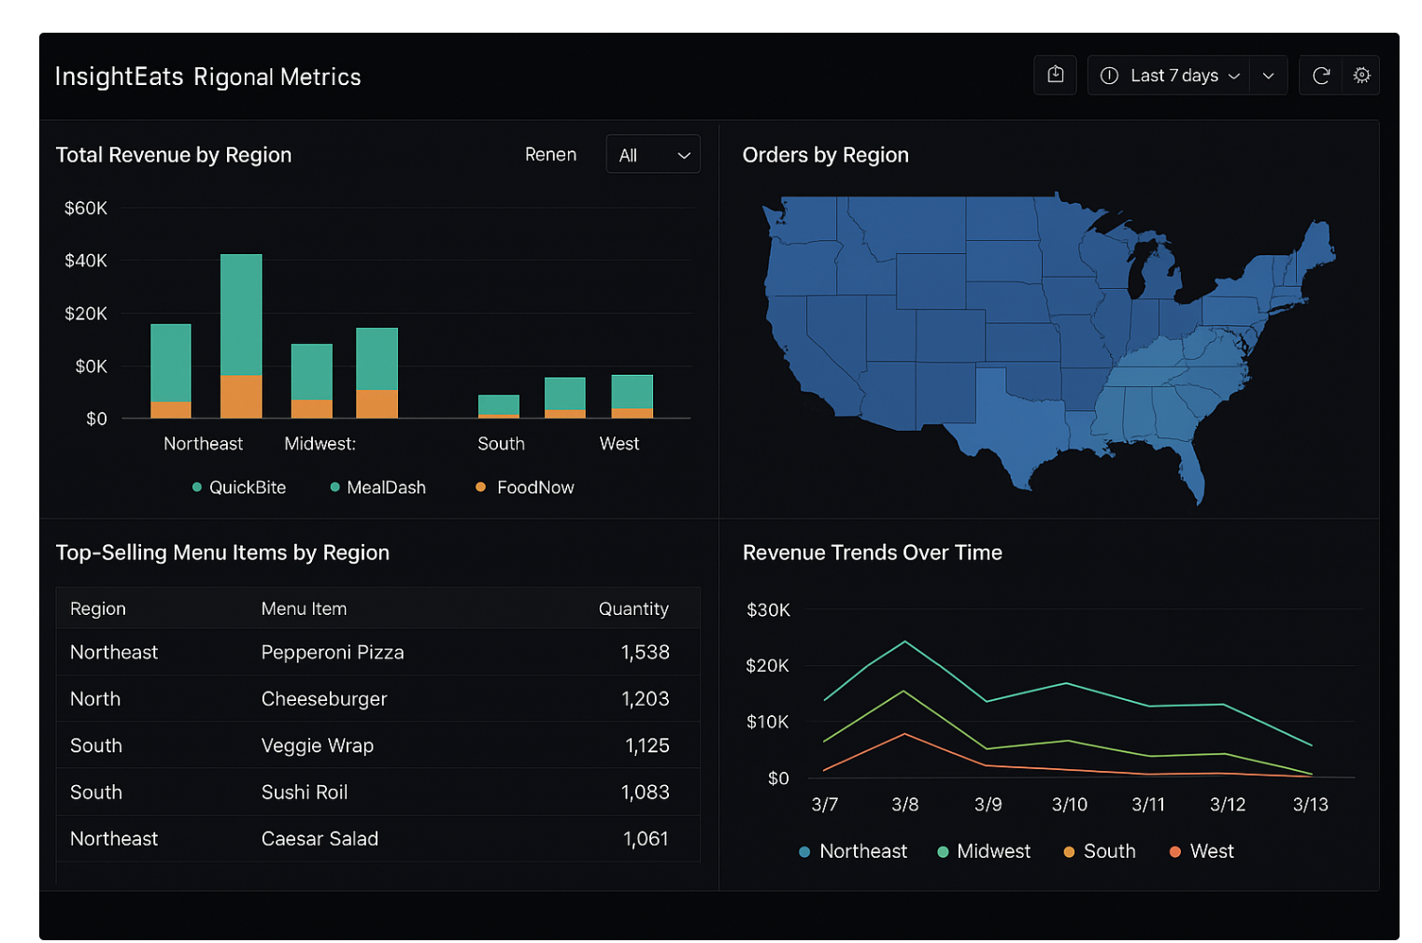
Exploratory Analysis for BI Revenue Dashboard
SQL shown in vs code

Slide 41
AI Integration
AI/ML Use Cases
1. Demand Forecasting
Goal: Predict orders per restaurant, menu item, or time window.
Data Required: Historical orders, promotions, menu changes, region, and events.
This will help with insights on predicting what promotions, menu changes in which regions potentially could drive more business/revenue
2. Fraud Detection
Goal: Identify anomalous orders, deliveries, or revenue transactions.
Data Required: Order details, revenue, delivery data, payment history, location data.
3. Menu Optimization
Goal: Recommend best-selling items, optimize pricing, and promotions.
Data Required: Orders, revenue, customer feedback, delivery performance, promotions

Slide 42
AI Integration - Steps
High-Level AI/ML Readiness Plan
Step 1: Define Use Cases & Labels
Identify the ML problems you want to solve:
Demand Forecasting → predict future orders per menu item / restaurant.
Fraud Detection → identify suspicious orders or revenue anomalies.
Menu Optimization → recommend best-selling items and promotions.
Determine labels for each use case:
Demand Forecasting → next-day or next-hour order count.
Fraud Detection → 0/1 flag based on historical fraud cases.
Menu Optimization → high_sales = 1 if item is top X% of sales.
Step 2: Prepare Features
Pull curated tables from existing pipelines (Orders, Menu, Revenue, Delivery).
Engineer features relevant to each ML use case:
Order trends (rolling averages, day-of-week effects)
Revenue patterns
Delivery success rates
Promotions active
Ensure features are timestamped and consistent across tables.

Slide 43
AI Integration - Steps
Step 3: Merge Features & Labels
Combine engineered features with their corresponding labels into a single ML dataset.
This dataset will be the training source for all models.
Step 4: Store Features in SageMaker Feature Store
Create feature groups for each ML domain (e.g., demand_forecasting, fraud_detection).
Ingest the ML dataset into the Feature Store:
Offline store → batch training
Online store → real-time inference if needed
Feature Store ensures centralized, versioned, and reusable features across multiple models.

Slide 44
Further Insights Needed
What is the quantity that we need to ingest per load averagely
Can be added to data contract
What are the actual fields present within each data source and do we need them all
Is historical data needed?
What is the retention time for the data?
What is the true purpose for monitoring revenue, performance and customer actions? ( for case study assuming its for time to insight for quicker and more efficient business decisions, example: what is the business’ core customer base demographic, which promotion is most used by customers)

Slide 45
Future implementations
Working end to end data pipeline in aws with mock food insights data

